Slide 1
Financial Accounting
BCA
1st Batch
2nd Semester

Slide 2
Meaning and concept of Accounting
Financial
Non- Financial
Record
Book keeping
Book-Collection of financial transaction
Keeping-Recording
Activities
Information
Events
Data
Transactions

Slide 3
Book keeping
Identification
Collecting
Recording
Classifying
Accounting
Analysis
Interpreting
Reporting
Communicating

Slide 4
Accounting
Accounting is an act of recording ,analyzing ,interpreting ,reporting & communicating the recorded data or transactions which have monetary value .it helps to find out profit and loss (result) and financial position about the business . It helps to provide necessary information to the various users.
Procedural aspects of accounting
Generating financial information
Using financial information

Slide 5
Generating financial information
Recording
Journal
Subsidiary book
Classifying
Analyzing
ledger
4. Summarizing
Trial balance
Trading ,profit and loss a/c
Balance sheet
5. Interpreting
6. reporting

Slide 6
Using financial info mating
Internal user : Owner, Management
External user :
-Inviters
-Employees
-Suppliers
-Lender
-Customer
-Government, public

Slide 7
Evolution of Accounting as social science
Traditional Accounting
Book keeping is a regarded as an accounting . The double entry book keeping has been developed 15th century .
The origin of book keeping can month be traced out. It has been practiced from ancient time.luca pacioli introduced book keeping in 1494 AD who lived in Italy. He published book named about of principles of double entry system .He started the term debit and credit use of memorandum (journal & ledger).

Slide 8
Management Accounting
Management Accounting is the process of analyzing .interpreting reporting the information which helps to decision making ,planning &controlling
_{Financial Accounting}
Financial Accounting concerned with identifying measuring & communicating the useful information of business. It includes disclosure of financial statement (i.e.. Profit & loss &balance sheet).

Slide 9
Social Responsibility Accounting
It is concerned with social , awareness ,pollution , resources of society quality product CSR (corporate social responsibility).
Objective of accounting
To record the financial transaction systematically as per as specified rules .
To find out the result of organization (profit and loss)
To ascertain the financial position .
To provide information to the users.

Slide 10
Function of accounting
Complete records: Human memory is limited and cannot remember for long period . Accounting helps to record completely financial transaction for future reference.
Knowledge of result: Accounting helps to find out result (profit and loss)during a certain period .
Financial position: Accounting helps to ascertain financial position (Assets and liabilities) of the business.

Slide 11
Cont…
Reporting information : Accounting provides necessary information to the various internal and external users.

Slide 12
Scope of Accounting
Trading concern :It has a scope in trading concern which are establish in profit making like wholesaler ,dealer, industry.
Non-trading : It has a scope in non-trading concern which are established in service making like hospital, transportation ,club ,trust.
Professional : it has a scope in an individual professional like doctor ,engineer, contractors
Government :It has scope in government accounting.

Slide 13
Sub-field of Accounting
Booking keeping
Financial Accounting(body)
Cost accounting(blood)
Management Accounting .(brain)
Tax Accounting
Auditing
Social Accounting

Slide 14
Limitation of Accounting
Records only monitory and historical data .
No consideration for price level changes.
Absents of cost analysis
Not unified method

Slide 15
Accounting concept, principles(GAAP)Generally Accepted Accounting Principles
Accounting concepts:
Going concept
Business entry concept
Matching concept
Accounting period concept
Money measurement concept
Cost concept
Revenue realization concept

Slide 16
Business entity concept
In this concept ,business is considered as separate entity from its owner .Transactions of business should be recorded separately .of personal transaction of owner is mixed up into business ,it can’t get actual result.
Going concept
Business will continue forever or long period .business never dies and thinks that it will be closed after some period ,it has unlimited life.
Matching concept
In this concept ,the expenses and incomes relating to certain period should be matches to find out the profit .any income and expenses of last year and coming year should not include in current year.

Slide 17
Accounting period concept
Business organization should be kept and closed with fixed period to know that profit and it may be started from bask ,shrawn,janary,or ended in chaitra,ashad,december.
Money management concept
According to this concept ,there is recorded only those transactions which is converted to monetary term,non-monetery activities like feeling ,emotion are not recorded .
Cost concept
All business transaction should be recorded the book of account of cost price at which they are purchased and paid actually .there is not considered increase and decrease in marker value.
Revenue realization concept
In this concept ,revenue is relished when goods and services are transferred to the customer either cash or pay cash in future.

Slide 18
Journal entries
Questions:
a.
Raj started business with cash Rs 50000.
Deposit cash into bank 10000.
Purchase goods on cash 5000.
Purchase good from hari 10000.
Purchase a computer for 45000.
Sold good on cash 20000.
Sold good to mohan 15000.
Paid salaries 4000.
Received rent 2500.
Withdraw cash by raj for personal use 4000.
Returned goods to hari 1000.
Returned goods from mohan 2000.
Depreciation on computer 10%.
Withdraw cash from bank 2000.
Require :journal entries

Slide 19
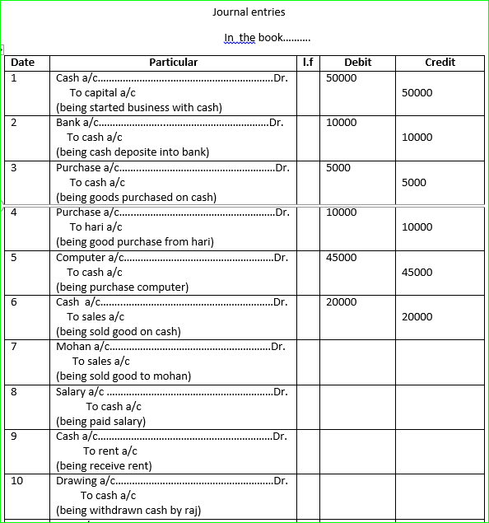

Slide 20
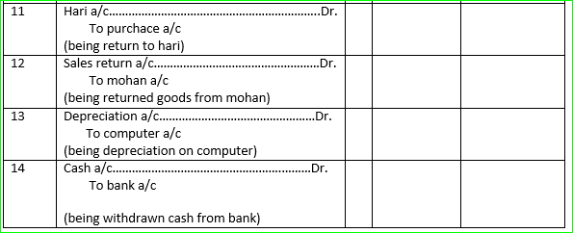

Slide 21
B.
Mr. Shrestha started business with cash 50000 and furniture 30000.
Purchase goods from ram for 20000 and paid cash only 12000.
Sold goods to hari for 15000 and received cheque 10000 partially.
Paid wage and salary 5000 and 8000 respectively.
Sold furniture codting 8000 at 5000.
Paid cash to ram 7500 in full settlement .
Received cash from hari 4800 in full settlement.
required: journal entries

Slide 22
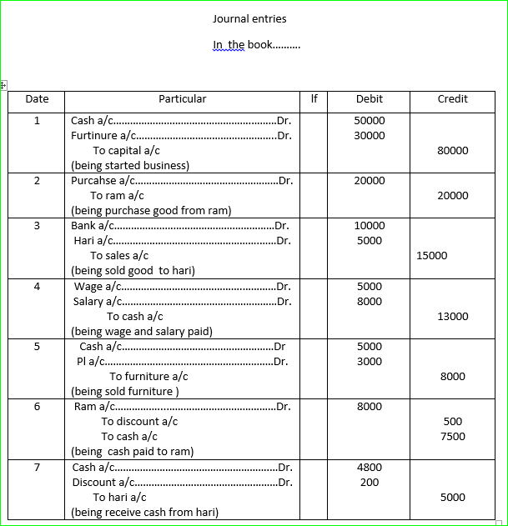

Slide 23
Company and its formation
Meaning of company
company is one of the important form of business organization .it is an associate by group of people who contribute money and they are united for common objectives .its an artificial person which is created by law and it can easily purchase or sale goods and other properties in its own name. it has also separate legal entity from its owner and lability of each member is limited .
features or characteristics of company
Artificial person : A company is an artifial person because it can purchase or sale valuable assets and goods on its own name like a natural person .
Legal entity : company is created by law and it has also distinct legal entity from its member so that personal transactions of the shareholder are recorded in the book of the company .
Limited liability : owner of the company is a liable to the value of share purchase only .the company cannot claim money more than nominal value of share to its shareholders .
Managed by BOD : the shareholder cannot involve directly in the company thus it is managed operated and controlled by board of directors.

Slide 24
Types of company
On the basis of formation/incorporation
Character company : A company which is established by Royal Charter or Head of state is called character company . In Nepal such type of company is not establish yet.
Statutory company : A company which is estabilshed by special act of parliament is called statutory company .Nepal Rastha bank ,Agriculture development bank is example of statuory company
Register company : A company which is established and registered under the company act is called registered company .

